Slide 1

ENN Interlocutors meeting May 2020
Overview of Project activities and calendar
www.enn-rne.eu

Slide 2
Contents
Overview on 2019 achievements. Building together
ENN 2020: Foreseen activities and state of play
ENN 2020: Work plan and Calendar

Slide 3
Overview of 2019 achievements. Building together
Implementation of dynamic cross-check forms.
A new monitoring system
Multiple-destination enquiries.
A new private forum for interlocutors: called E-Agora
Interconnection of the ENN legal databases and the CNUE information sources.
New tool on the rights of representation of companies
Communication: A promotional video on the ENN

Slide 4
ENN 2020 Foreseen activities
ENN interlocutors meetings and workshops
Updating legal information: Vulnerables in Europe website
New tool for notarial practice: Handbook circulation of public documents
Improvements and new features in ENN platform
Communication strategy

Slide 5
ENN 2020 Foreseen activities
I ENN interlocutors meetings and workshops
Warsaw (Poland) May 2020. Workshop postponed.
Sofia (Bulgaria) Beginning of September

Slide 6
ENN 2020 Foreseen activities
II Updating legal information. Vulnerables in Europe Website
Review of content. Adaptation for a non- expert audience.
Review of design. Adaptation disabled people.
Drafting of new content to be finalized by september

Slide 7
ENN 2020 Foreseen activities
III New tool for notarial practice: Handbook on circulation of public documents
Drafting of the guide. Group of volunteer meet on April to set work baselines
Electronic format navigable guide. Translation EN and FR
Drafting of the guide to be finalized by July

Slide 8
ENN 2020 Foreseen activities
IV Improvements and new features in ENN platform
Specialised network in data protection
Cross check on-line formulaire to be sent through platform
Increasing usability and intuitiveness of the platform

Slide 9
ENN 2020 Foreseen activities
V Communication strategy
A centralised communication strategy for the next three years with yearly objectives and activities
Increase the knowledge and use of the ENN and its tools among practitioners

Slide 10
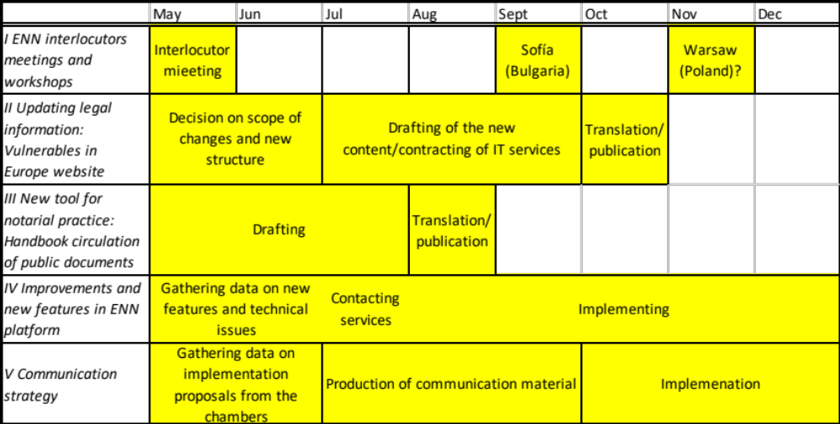
ENN Workplan and calendar

